Slide 1
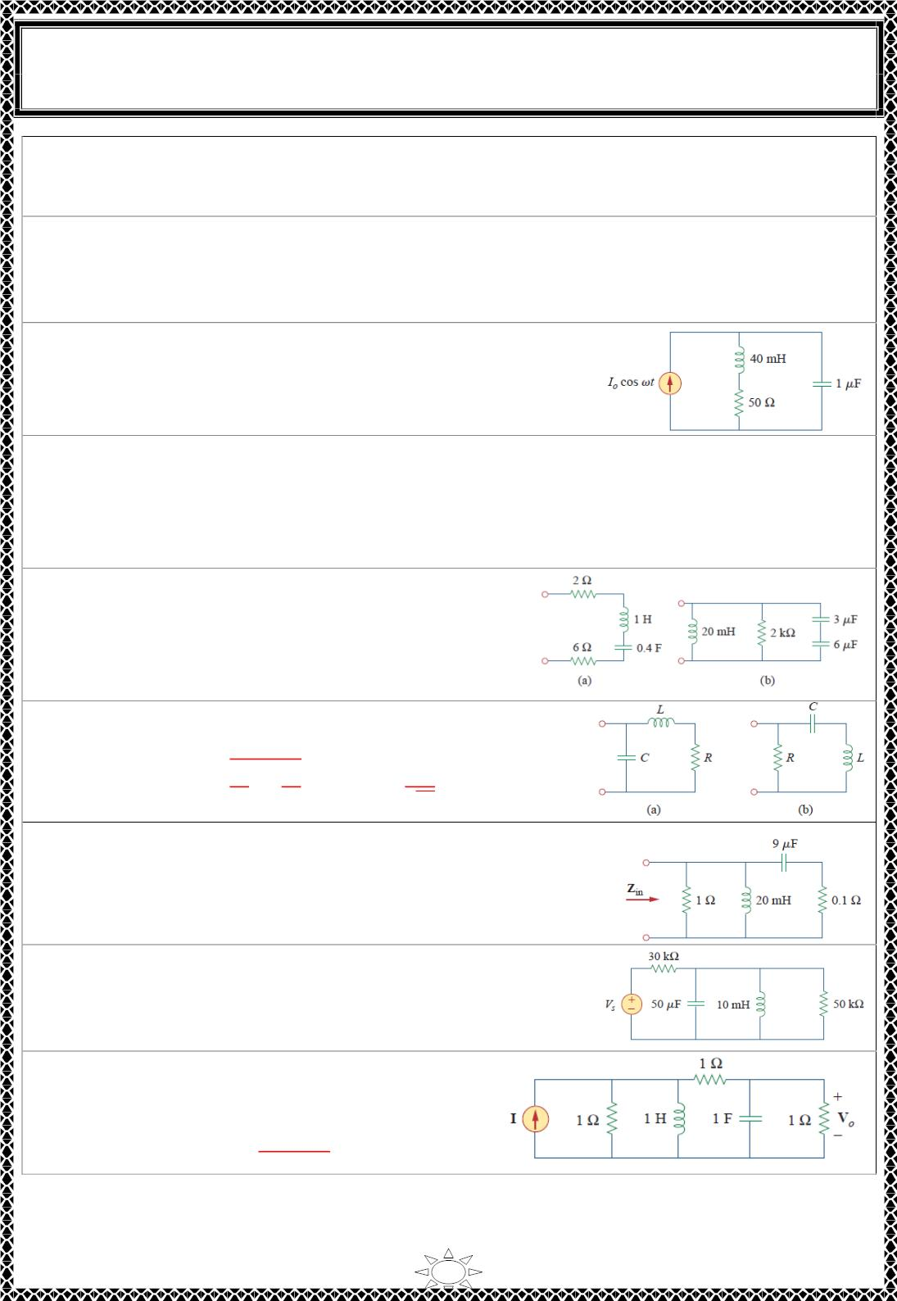
University of Diyala
Engineering College
Electronic Department
Electrical Circuits
2nd Class
Lecturer : Wisam N. AL-Obaidi
Year (2015-2016)
H.W.(15): A parallel RLC circuit has R = 5kΩ, L = 8 mH, and C = μF. Determine:
(a) the resonant frequency (b) the bandwidth (c) the quality factor
[Answer: 40Ω, 10 μF, 2.5 μH, 2.5 krad / s, 198.75 krad/s, 201.25 krad/s]
H.W.(16): It is expected that a parallel RLC resonant circuit has a midband admittance of
25 × 110 ⁻³ S, quality factor of 80, and a resonant frequency of 200 krad/s. Calculate the
values of R, L, and C. Find the bandwidth and the half-power frequencies.
[Answer: 40Ω, 10 µF, 2.5 µH, 2.5 krad/ s, 198.75 krad/s, 201.25 krad/s]
H.W.(17): For the circuit in Fig, find the resonant
frequency.
[Answer: 4.841 krad/s]
H.W.(18): A parallel resonance circuit has a resistance of 2 k Ω and half-power
frequencies of 86 kHz and 90 kHz. Determine:
(a) the capacitance (b) the inductance (c) the resonant frequency (d) the bandwidth (e) the
quality factor
[Answer: (a)19.89Nf (b) 164.45 μH (c) 552.9krad / s (d) 25.13krad / s (e)Q = 22 ]
H.W.(19): For the circuits in Fig, find the resonant
frequency ω_{o} , the quality factor Q, and the
bandwidth B.
[Answer: (a) 1.5811 rad / s, Q = 0.1976, B = 8 rad
/ s (b) 5 krad / s, Q = 20, B = 250 rad / s]
H.W.(20): Calculate the resonant frequency of each of the
circuits in Fig.
Trail Version
Trail Version
Trail Version
Trail Version
Trail Version
Trail Version
Trail Version
Trail Version
Trail Version
Trail Version
Trail Version
Trail Version
Trail Version
ퟏ
푹^{ퟐ}
푳^{ퟐ}
ퟏ
[Answer:(a)흎_{ퟎ} =
√ −
푳푪
(b)
흎_{ퟎ} =
]
ꢀ푳푪
H.W.(21): For the circuit in Fig., find:
(a) the resonant frequency ω_{o}
(b) Z (ω )
in
0
[Answer (a) 2.357 krad/ s (b) 1Ω
H.W.(22): For the circuit shown in Fig., find ω₀ , B, and Q,
as seen by the voltage across the inductor.
[Answer: ω0 = 447.21 rad/s, B = 1.067 rad/s, Q = 419.13 ]
H.W.(23): For the network shown in Fig., find
(a) the transfer function H(ω ) = V_{o} (ω )/I(ω ),
(b) the magnitude of H at ω_{o} = 1 rad/s.
[Answer: (a) 퐇(흎) =
풋흎
(b) 0.25]
ퟐ(ퟏ+퐣훚)^{ퟐ}
4

Slide 2
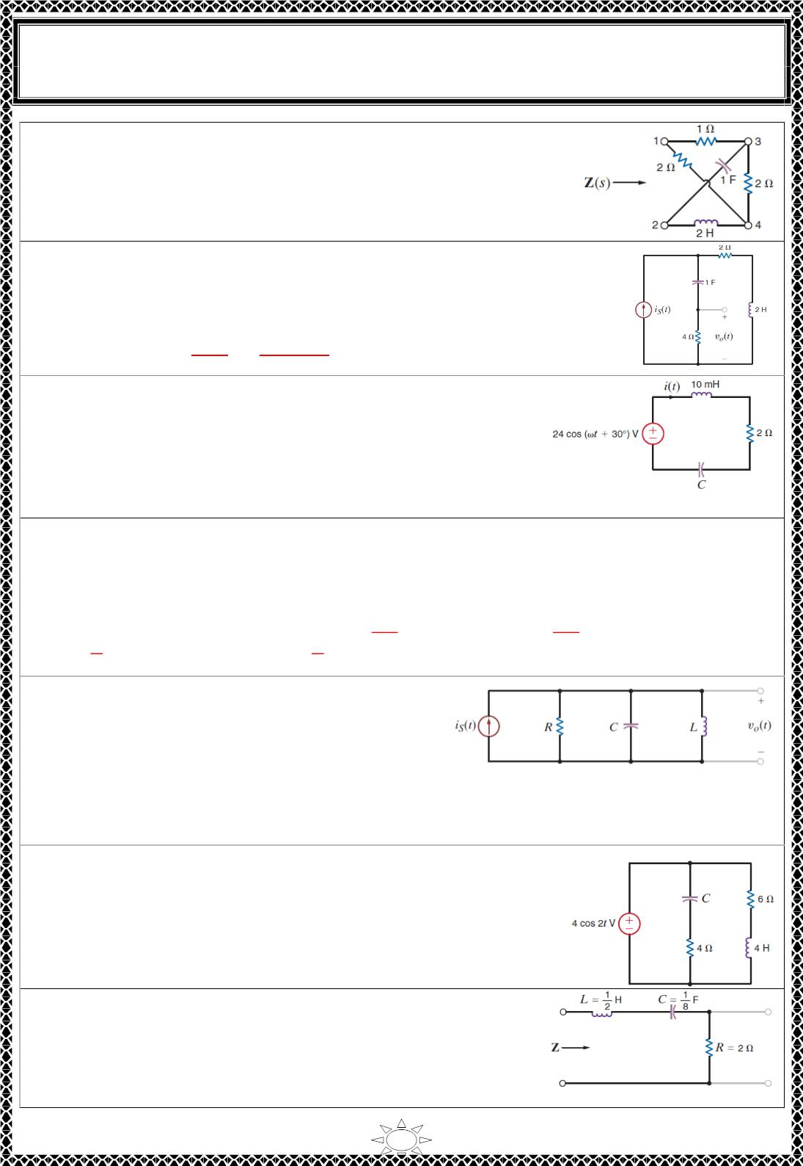
University of Diyala
Engineering College
Electronic Department
Electrical Circuits
2nd Class
Lecturer : Wisam N. AL-Obaidi
Year (2015-2016)
H.W.(24): Determine the driving point impedance at the input
terminals of the network shown.
[Answer:]
H.W.(25): Find the transfer impedance or transfer function V (s)/I (s)
for the network shown in Fig.
o
s
[Answer: 퐇(풔) =
^{푽}ퟎ^{(풔)}
푰_{풔}(풔)
=
ퟖ풔
]
ퟐ풔^{ퟐ}+ퟔ풔+ퟏ
H.W.(26): The series RLC circuit in Fig. is driven by a
variable-frequency source. If the resonant frequency of the
network is selected as ω₀ = 1600 rad/s, find the value of C. In
addition, compute the current at resonance and at ω₀/4 and
4ω₀.
[Answer: C = 39 µF,푰(흎 ) = ퟏퟐ∠ퟑퟎ^{푶}. 푰(흎 /ퟒ) = ퟎ ∙ ퟒ∠ퟏퟏퟖ^{푶}. 푰(ퟒ흎 ) = ퟎ ∙ ퟒ∠−ퟓퟖ^{푶}]
ퟎ
ퟎ
ퟎ
H.W.(27): A parallel RLC circuit, which is driven by a variable frequency 2-A current
source, has the following values: R = 1 kΩ, L = 100mH and C = 10 µF. Find the
bandwidth of the network, the half-power frequencies, and the voltage across the network
at the half-power frequencies.
Trail Version
Trail Version
Trail Version
Trail Version
Trail Version
Trail Version
Trail Version
Trail Version
Trail Version
Trail Version
Trail Version
Trail Version
Trail Version
풓풂풅
풓풂풅
[Answer: B = 100 rad/s, 흎_{ퟏ} = ퟗퟓퟏ ∙ ퟐퟓ
. 흎_{ퟐ} = ퟏퟎퟓퟏ ∙ ퟐퟓ
.
풔
풔
푽 = √ퟐ ∠ퟒퟓ^{풐} 풌푽 풂풕 흎 . 푽 = √ퟐ ∠−ퟒퟓ^{풐} 풌푽 풂풕 흎 ]
ퟏ
ퟐ
H.W.(28): The source in the network in Fig. is
푖_{푠}(푡) = cos 1000푡 ꢀ cos 1500푡 퐴. R = 200 Ω
and C = 500 µF . If ω₀ = 1000 rad/s, find L, Q,
and the BW. Compute the output voltage 푣ꢁ(푡)
and discuss the magnitude of the output voltage at the two input frequencies.
[Answer: L = 2 mH, Q = 100, B = 10 rad/s, 풗 (풕) = ퟐퟎퟎ풄풐풔 ퟏퟎퟎퟎ풕 ꢀ ퟐ ∙
ퟒ풄풐풔(ퟏퟓퟎퟎ풕 − ퟖퟗ ∙ ퟑퟏ^{ퟎ})푽]
ퟎ
H.W.(29): Determine the value of C in the network shown in
Fig. for the circuit to be in resonance.
[Answer: either C = 345 mF or C = 45 mF]
H.W.(30): Determine the new parameters of the network
shown in Fig. if Z_{new} = 10⁴Z_{old}
[Answer: Lnew = 5 kH, Cnew = 12.5 µF, Rnew = 20 kΩ]
5

Slide 3
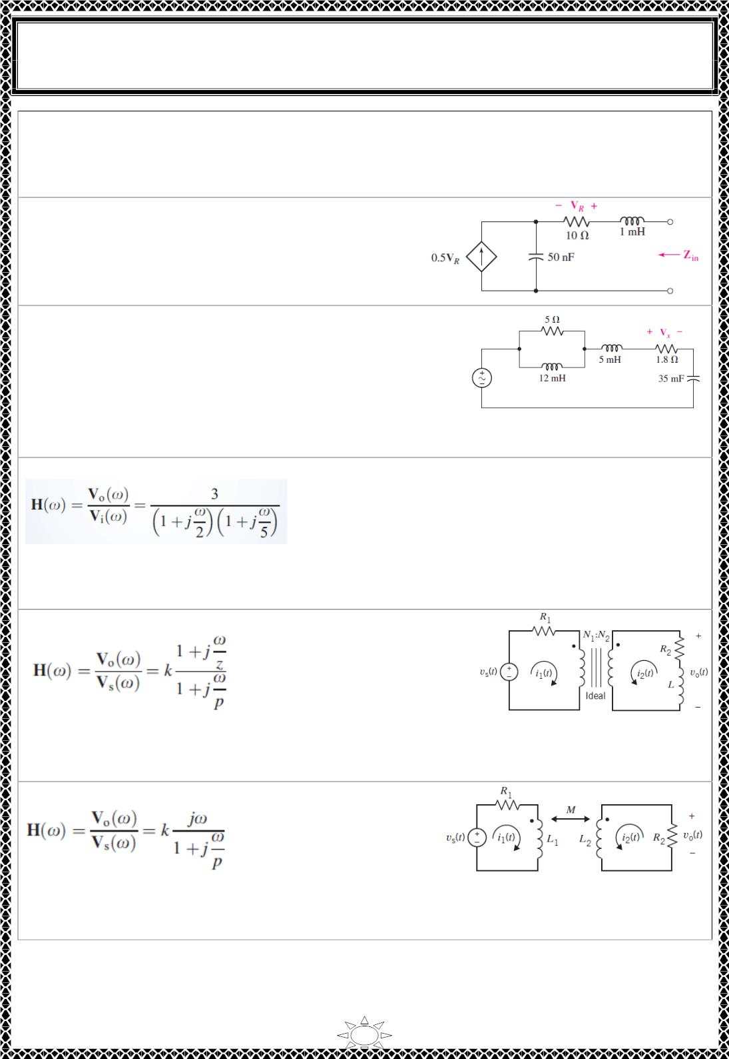
University of Diyala
Engineering College
Electronic Department
Electrical Circuits
2nd Class
Lecturer : Wisam N. AL-Obaidi
Year (2015-2016)
H.W.(31): A parallel RLC network is constructed using R = 5 Ω, L = 100 mH, and C = 1
mF. (a) Compute Q₀. (b) Determine at which frequencies the impedance magnitude drops
to 90% of its maximum value.
[Answer: (a) 0.5 (b) ω = 62.7 rad/s; ω = 159.5 rad/s]
1
1
H.W.(32): After deriving Z (s) in Fig., find (a) ω ;
(b) Q₀.
in
0
[Answer: Z = R + j(ωL – 1/ωC), ω0=1.4*10⁵;
Q0=14.1]
H.W.(33): For the circuit shown in Fig., the voltage
source has magnitude 1 V and phase angle 0◦. Determine
the resonant frequency ω and the value of V at 0.95ω .
0
x
0
[Answer: At ω0 set imaginary part of input
impedance, Z(ω), to zero to obtain ω0 = 41 rad/s.
Then, Z(0.95ω ) = Ζ(39) = 1.845 ∠-2.2⁰ Ω, I (39) = 0.542 ∠2.2º A and
0
s
Vx(39) = 0.98 ∠2.2⁰ V]
H.W.(34): The network function that represents this circuit is
Trail Version
Trail Version
Trail Version
Trail Version
Trail Version
Trail Version
Trail Version
Trail Version
Trail Version
Trail Version
Trail Version
Trail Version
Trail Version
Determine the value of the inductance L and of the gain A of the voltage-controlled
voltage source (VCVS).
[Answer: A =3 and L = 2H.]
H.W.(35): The network function of this circuit is
Determine expressions that relate the network function parameters k, z, and p to the circuit
parameters R , R , L, N , and N .
[Answer:]
1
2
1
2
H.W.(36): The network function of this circuit is
Determine expressions that relate the network function parameters k and p to the circuit
parameters R , R , M, L , and L .
[Answer:]
1
2
1
2
6

Slide 4
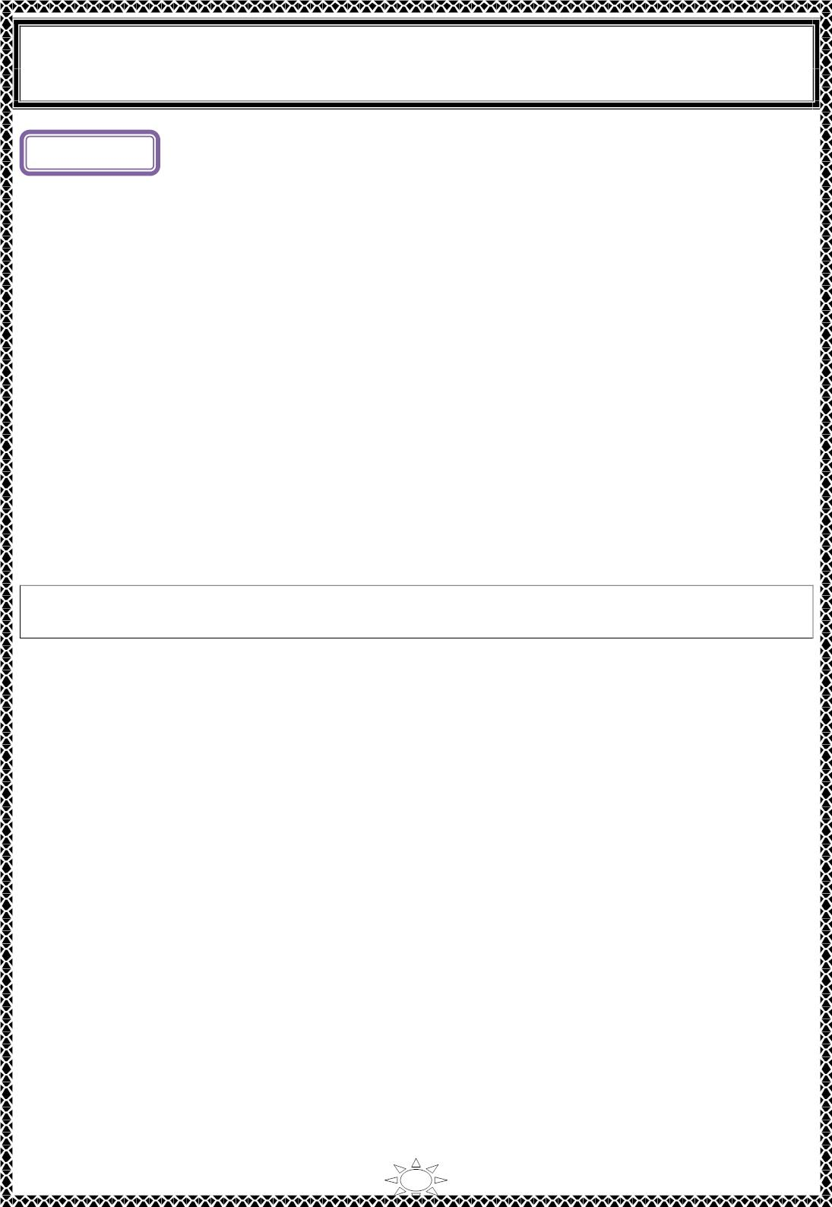
University of Diyala
Engineering College
Electronic Department
Electrical Circuits
2nd Class
Lecturer : Wisam N. AL-Obaidi
Year (2015-2016)
Lecture ( )
Passive Filters
1) Introduction
The reactances of inductors and capacitors depend on the frequency of the a.c. signal
applied to them. That is why these devices are known as frequency-selective. By using
various combinations of resistors, inductors and capacitors, we can make circuits that have
the property of passing or rejecting either low or high frequencies or bands of frequencies.
These frequency selective networks, which alter the amplitude and phase characteristics of
the input a.c. signal, are called filters. Their performance is usually expressed in terms of
how much attenuation a band of frequencies experiences by passing through them.
Attenuation is commonly expressed in terms of decibels (dB).
As a frequency-selective device, a filter can be used to limit the frequency spectrum of
a signal to some specified band of frequencies. Filters are the circuits used in radio and TV
receivers to allow us to select one desired signal out of a multitude of broadcast signals in
the environment.
Trail Version
Trail Version
Trail Version
Trail Version
Trail Version
Trail Version
Trail Version
Trail Version
Trail Version
Trail Version
Trail Version
Trail Version
Trail Version
A filter is a circuit that is designed to pass signals with desired frequencies and
reject or attenuate others.
2) Types of Electrical Filters
1) A passive filter is a filter consists of only passive elements R, L, and C.
2) An active filter is a filter consists of active elements (such as transistors and op
amps) in addition to passive elements R, L, and C.
We consider passive filters in this section. LC filters have been used in practical
applications for more than eight decades. LC filter technology feeds related areas such as
equalizers, impedance-matching networks, transformers, shaping networks, power
dividers, attenuators, and directional couplers, and is continuously providing practicing
engineers with oppurtunities to innovate and experiment.
There are four types of filters whether passive or active:
1. A lowpass filter passes low frequencies and stops high frequencies, as shown ideally in
Fig.2.1 (a).
2. A highpass filter passes high frequencies and rejects low frequencies, as shown ideally in
Fig.2.1 (b).
3. A bandpass filter passes frequencies within a frequency band and blocks or attenuates
frequencies outside the band, as shown ideally in Fig.2.1 (c).
4. A bandstop filter (or band-rejection) passes frequencies outside a frequency band and blocks
or attenuates frequencies within the band, as shown ideally in Fig.2.1 (d).
1

Slide 5
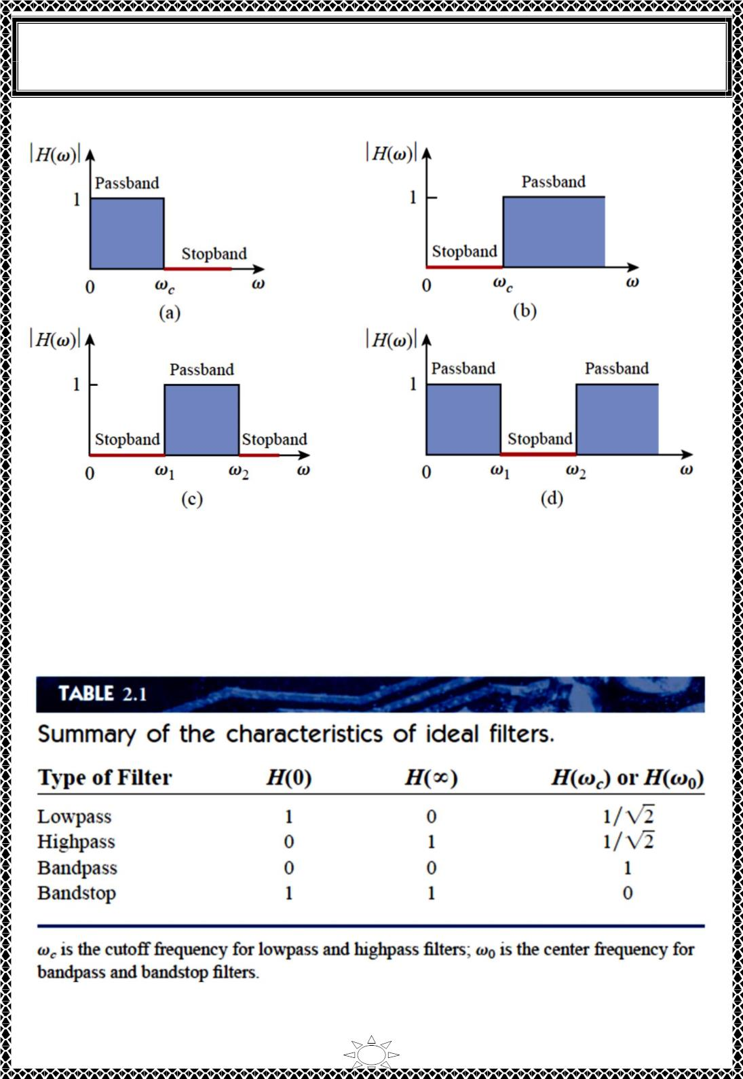
University of Diyala
Engineering College
Electronic Department
Electrical Circuits
2nd Class
Lecturer : Wisam N. AL-Obaidi
Year (2015-2016)
Trail Version
Trail Version
Trail Version
Trail Version
Trail Version
Trail Version
Trail Version
Trail Version
Trail Version
Trail Version
Trail Version
Trail Version
Trail Version
Fig.2.1 Ideal frequency response of four types of filter:
(a) lowpass filter, (b) highpass filter, (c) bandpass filter, (d) bandstop filter.
Table 2.1 presents a summary of the characteristics of these filters. Be aware that the
characteristics in Table 2.1 are only valid for first- or second-order filters—but one should
not have the impression that only these kinds of filter exist. We now consider typical
circuits for realizing the filters shown in Table 2.1.
2

Slide 6
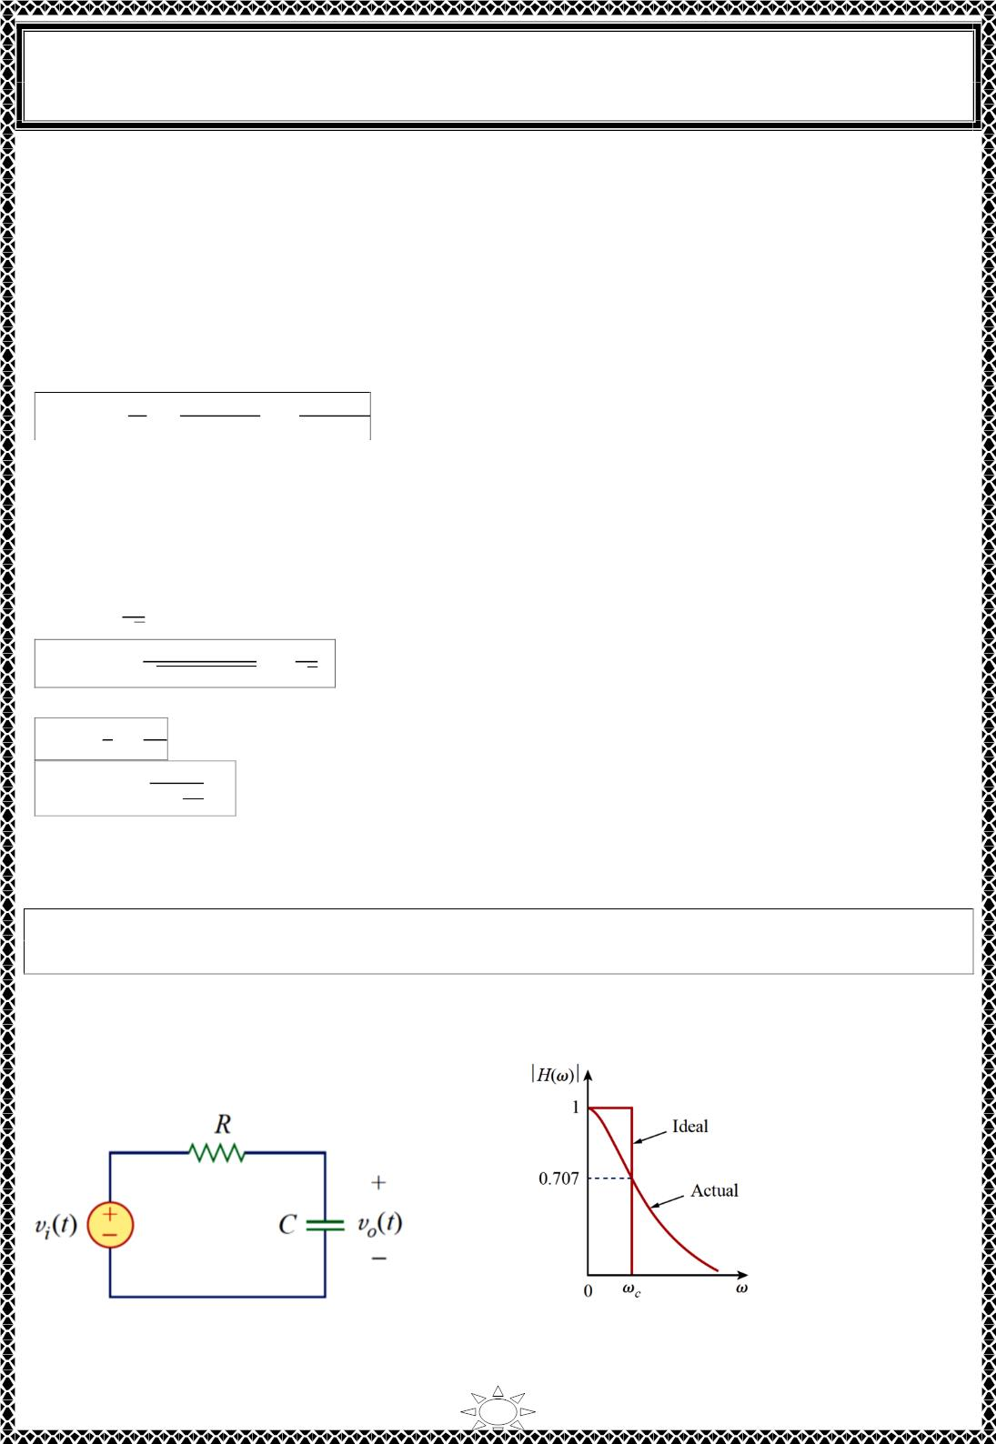
University of Diyala
Engineering College
Electronic Department
Electrical Circuits
2nd Class
Lecturer : Wisam N. AL-Obaidi
Year (2015-2016)
2.1) Lowpass Filter
2.1.1) RC LowPass Filter: A typical lowpass filter is formed when the output of an RC
circuit is taken off the capacitor as shown in Fig.2.2. At low frequencies, the capacitor has
a very large reactance. Consequently, at low frequencies the capacitor is essentially an
open circuit resulting in the voltage across the capacitor, V_{out}, to be essentially equal to the
applied voltage, V_{in}. At high frequencies, the capacitor has a very small reactance, which
essentially short-circuits the output terminals. The voltage at the output will therefore
approach zero as the frequency increases. The transfer function (see also Example1) is
푉
1/푗ꢀ퐶
1
표
퐻(휔) =
=
=
…(2.1)
푉
푅+1/푗ꢀ퐶
1+푗ꢀ푅퐶
푖
Note that 퐇(0) = ꢁ. 퐇(∞) = 0. Fig.2.3 shows the plot of |퐇(ω) | along with the ideal
characteristic. The range of frequencies passed by a filter within specified limits is called
the passband of the filter. The half-power frequency, which is equivalent to the corner
frequency on the Bode plots but in the context of filters is usually known as the cutoff
(ω)
frequency (or roll off or break or critical frequency) is obtained by setting the magnitude of 퐇
ퟏ
equal to thus,
√ퟐ
퐻(휔_{푐}) =
1
1
=
…(2.2)
Trail Version
Trail Version
Trail Version
Trail Version
Trail Version
Trail Version
Trail Version
Trail Version
Trail Version
Trail Version
Trail Version
Trail Version
Trail Version
ꢂ1+ꢀ_{ꢃ}²푅²퐶²
√ꢄ
For the RC circuit, the cutoff frequency occurs at
1
1
휔_{푐} =
=
…(2.3)
…(2.4)
휏
푅퐶
∴ 퐻(휔) =
1
ꢅ
1+푗_{ꢅ}
ꢃ
Note: cutoff frequency sometimes called -3db frequency because the output voltage is down 3 dB
from its maximum at this frequency. The term dB (decibel) is a commonly used unit in filter
measurements.
A lowpass filter is designed to pass only frequencies from dc up to the cutoff
frequency ωc.
Note: The cutoff frequency is the frequency at which the transfer function H drops in
magnitude to 70.71% of its maximum value. It is also regarded as the frequency at which
the power dissipated in a circuit is half of its maximum value.
Fig.2.2 A lowpass filter
Fig.2.3 Ideal and actual frequency response
of a lowpass filter
3

Slide 7
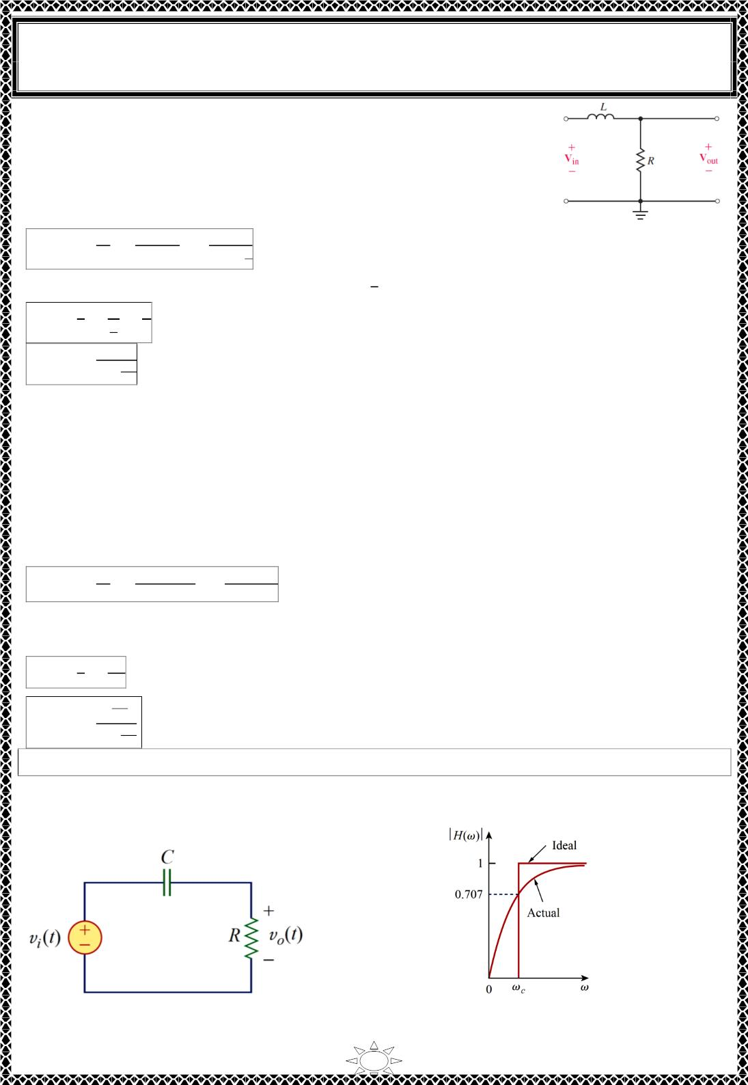
University of Diyala
Engineering College
Electronic Department
Electrical Circuits
2nd Class
Lecturer : Wisam N. AL-Obaidi
Year (2015-2016)
2.1.2) The RL LowPass Filter: A low-pass filter circuit may be
made up of a resistor and an inductor as illustrated in Fig.2.4. In a
manner similar to that used for the RC low-pass filter, we may
write the transfer function for the circuit of Fig.2.4 as follows:
푉
푅
1
표
퐻(휔) =
=
=
1+푗ꢀꢁ
…(2.5)
Fig.2.4 RL lowpass filter
푉_{푖}
푅+푗ꢀ퐿
ꢂ
1
Since the cutoff frequency is found as 휔_{푐} = . 푠ꢃ
1
1
푅
휏
휔_{푐} = = =
…(2.6)
…(2.7)
휏
ꢁ
퐿
ꢂ
퐻(휔) =
1
ꢄ
1+푗_{ꢄꢅ}
2.2) Highpass Filter
2.2.1) RC HighPass Filter: A highpass filter is formed when the output of an RC circuit is
taken off the resistor as shown in Fig.2.5. At low frequencies, the reactance of the
capacitor will be very large, effectively preventing any input signal from passing through
to the output. At high frequencies, the capacitive reactance will approach a short-circuit
condition, providing a very low impedance path for the signal from the input to the output.
The transfer function is
Trail Version
Trail Version
Trail Version
Trail Version
Trail Version
Trail Version
Trail Version
Trail Version
Trail Version
Trail Version
Trail Version
Trail Version
Trail Version
푉
푅
푗ꢀ푅퐶
표
퐻(휔) =
=
=
…(2.8)
푉_{푖}
푅+1/푗ꢀ퐶
1+푗ꢀ푅퐶
Note that 퐇(0) = 0. 퐇(∞) = ꢆ. Fig.2.6 shows the plot of |퐇(ω) |. Again, the corner or
cutoff frequency is
1
1
휔_{푐} =
=
…(2.9)
휏
푅퐶
ꢄ
푗
퐻(휔) = ꢄꢅ
…(2.10)
ꢄ
1+푗_{ꢄꢅ}
A highpass filter is designed to pass all frequencies above its cutoff frequency ωc.
A highpass filter can also be formed when the output of an RL circuit is taken off the
inductor.
Fig.2.5 A highpass filter
Fig.2.6 Ideal and actual frequency response
of a highpass filter
4

Slide 8
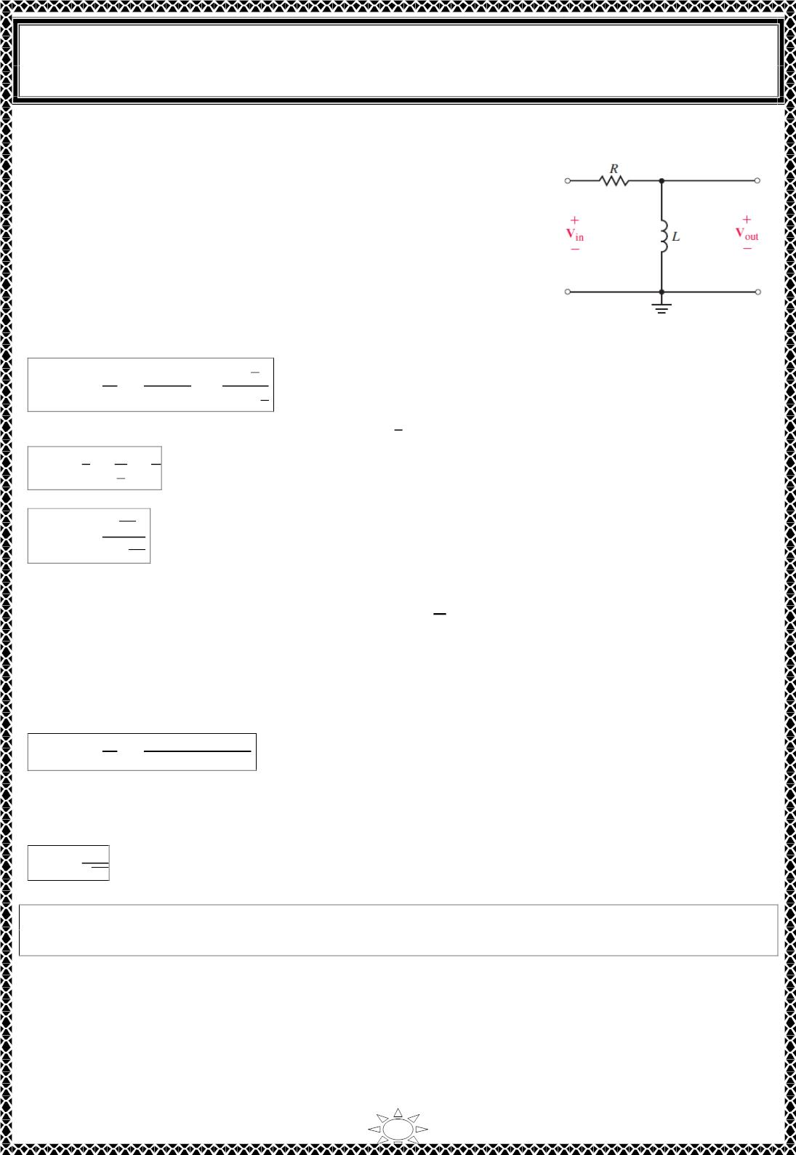
University of Diyala
Engineering College
Electronic Department
Electrical Circuits
2nd Class
Lecturer : Wisam N. AL-Obaidi
Year (2015-2016)
2.2.2) RL HighPass Filter
A typical RL high-pass filter circuit is shown in Fig.2.7. At
low frequencies, the inductor is effectively a short circuit,
which means that the output of the circuit is essentially zero at
low frequencies. Inversely, at high frequencies, the reactance
of the inductor approaches infinity and greatly exceeds the
resistance, effectively preventing current. The voltage across
the inductor is therefore very nearly equal to the applied input
voltage signal. The transfer function for the high-pass RL
circuit is derived as follows:
푗ꢀꢁ
Fig.2.7. RL high-pass filter
푉
푗ꢀ퐿
표
퐻(휔) =
=
=
ꢂ
…(2.11)
푉_{푖}
푅+푗ꢀ퐿
ꢁ
ꢂ
1+푗ꢀ
1
Since the cutoff frequency is found as 휔_{푐} = . 푠ꢃ
1
1
푅
휏
휔_{푐} = = =
…(2.12)
…(2.13)
휏
ꢁ
퐿
ꢂ
ꢄ
푗
Trail Version
Trail Version
Trail Version
Trail Version
Trail Version
Trail Version
Trail Version
Trail Version
Trail Version
Trail Version
Trail Version
Trail Version
퐻(휔) = ꢄꢅ
Trail Version
ꢄ
1+푗_{ꢄꢅ}
The preceding expression is identical to the transfer function for a high-pass RC filter,
퐿
with the exception that in this case we have ꢆ = .
푅
2.3) Bandpass Filter
The RLC series resonant circuit provides a bandpass filter when the output is taken off the
resistor as shown in Fig.2.7. The transfer function is
푉
푅
표
퐻(휔) =
=
…(2.14)
푉
푅+푗(ꢀ퐿−1/ꢀ퐶)
푖
We observe that 퐇(0) = 0. 퐇(∞) = 0. Fig.2.8 shows the plot of |퐇(ω) |. The bandpass
filter passes a band of frequencies (흎 < 흎 < 흎 ) centered on 흎 the center frequency,
which is given by
ퟏ
ퟐ
ퟎ
1
휔_{푐} =
√퐿퐶
…(2.15)
A bandpass filter is designed to pass all frequencies within a band of frequencies,
흎_{ퟏ} < 흎 < 흎_{ퟐ}
Since the bandpass filter in Fig.2.7 is a series resonant circuit, the half-power frequencies,
the bandwidth, and the quality factor are determined as in series resonant circuit. A
bandpass filter can also be formed by cascading the lowpass filter (where 흎 = 흎 ) in
ퟐ
풄
Fig.2.2 with the highpass filter (where 흎 = 흎 ) in Fig.2.5. However, the result would not
ퟏ
풄
be the same as just adding the output of the lowpass filter to the input of the highpass filter,
because one circuit loads the other and alters the desired transfer function.
5

Slide 9
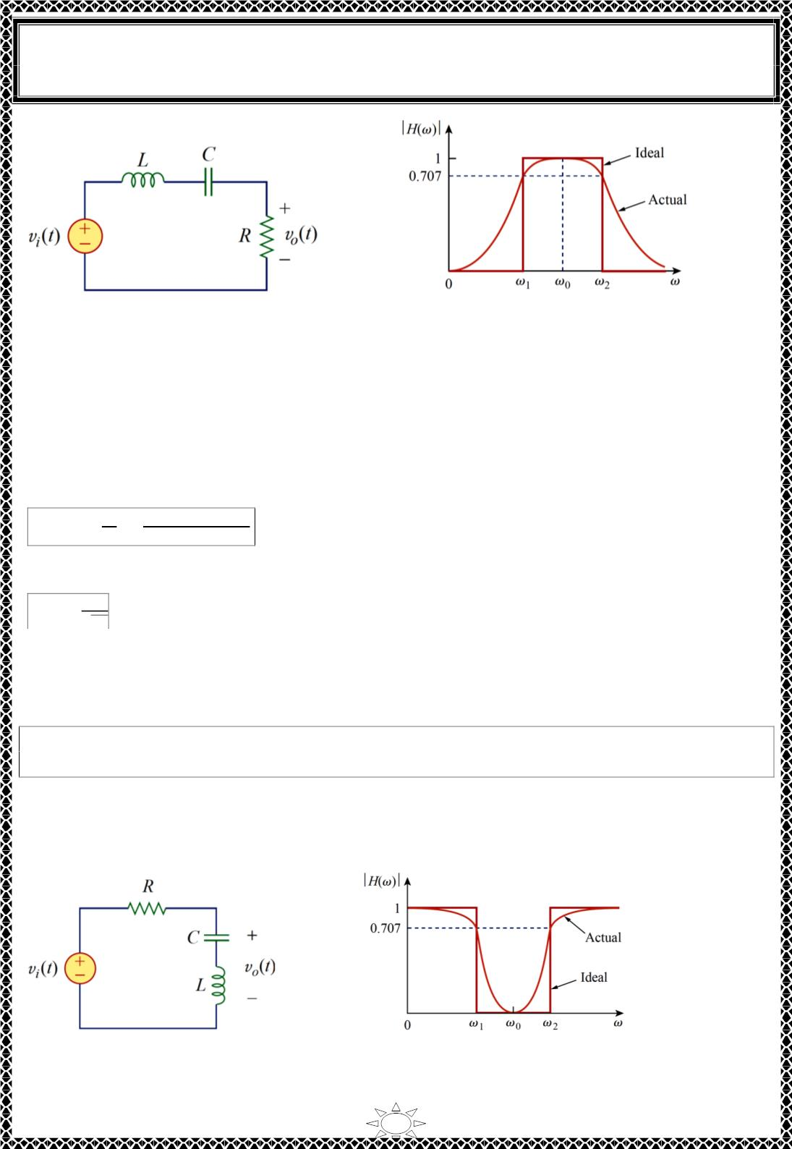
University of Diyala
Engineering College
Electronic Department
Electrical Circuits
2nd Class
Lecturer : Wisam N. AL-Obaidi
Year (2015-2016)
Fig.2.7 A bandpass filter
Fig.2.8 Ideal and actual frequency response
of a bandpass filter
2.4) Bandstop Filter
A filter that prevents a band of frequencies between two designated values (흎 and 흎 )
ퟏ
ퟐ
from passing is variably known as a bandstop, bandreject, or notch filter. A bandstop filter is
formed when the output RLC series resonant circuit is taken off the LC series combination
as shown in Fig.2.9. The transfer function is
푉
푗(ꢀ퐿−1/ꢀ퐶)
표
퐻(휔) =
=
…(2.16)
Trail Version
Trail Version
Trail Version
Trail Version
Trail Version
Trail Version
Trail Version
Trail Version
Trail Version
Trail Version
Trail Version
Trail Version
Trail Version
푉
푅+푗(ꢀ퐿−1/ꢀ퐶)
푖
Note that 퐇(0) = ꢁ. 퐇(∞) = ꢁ. Fig.2.10 shows the plot of |퐇(ω) |. Again, the corner or
cutoff frequency is
휔_{푐} =
1
…(2.17)
√퐿퐶
while the half-power frequencies, the bandwidth, and the quality factor are calculated
using the formulas for a series resonant circuit. Here, 흎_{ퟎ} is called the frequency of rejection,
while the corresponding bandwidth (푩 = 흎 ꢂ 흎 ) is known as the bandwidth of rejection.
Thus,
ퟐ
ퟏ
A bandstop filter is designed to stop or eliminate all frequencies within a band of
frequencies, 흎 < 흎 < 흎 .
ퟏ
ퟐ
Notice that adding the transfer functions of the bandpass and the bandstop gives unity at any
frequency for the same values of R, L, and C. Of course, this is not true in general but true
for the circuits treated here. This is due to the fact that the characteristic of one is the
inverse of the other.
Fig.2.9 A bandstop filter
Fig.2.10 Ideal and actual frequency response
of a bandstop filter
6

Slide 10
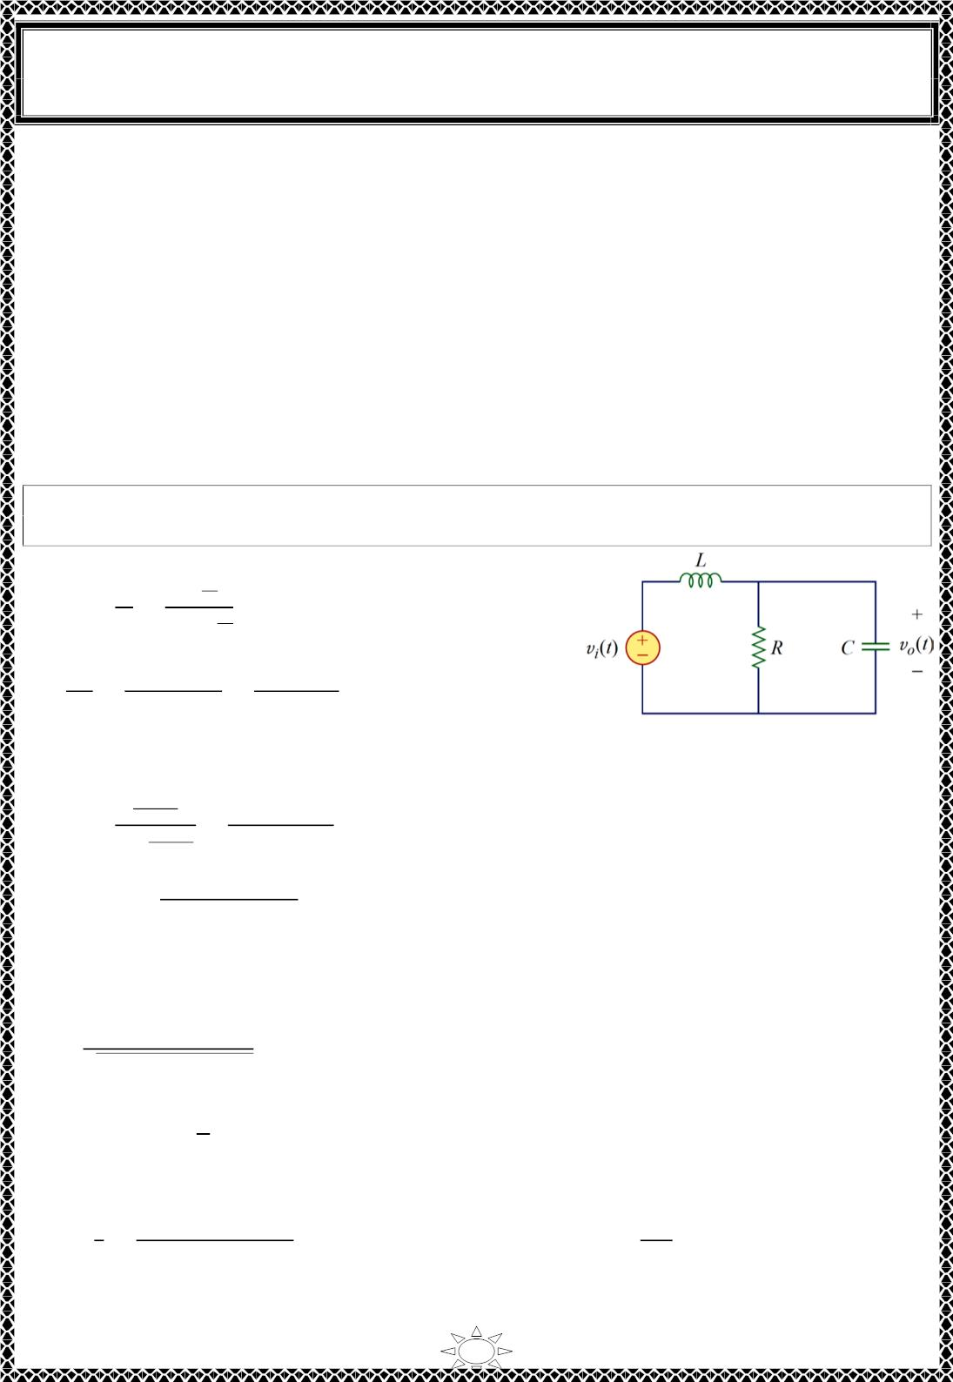
University of Diyala
Engineering College
Electronic Department
Electrical Circuits
2nd Class
Lecturer : Wisam N. AL-Obaidi
Year (2015-2016)
We should note that:
1. From Eqs. (2.1), (2.5), (2.8), (2.11), (2.14), and (2.16), the maximum gain of a passive
filter is unity. To generate a gain greater than unity, one should use an active filter.
2. There are other ways to get the types of filters.
3. The filters treated here are the simple types. Many other filters have sharper and
complex frequency responses.
There are three major limitations to the passive filters considered in the previous section.
First, they cannot generate gain greater than 1; passive elements cannot add energy to the
network. Second, they may require bulky and expensive inductors. Third, they perform
poorly at frequencies below the audio frequency range (300 Hz < f < 3000 Hz)
Nevertheless, passive filters are useful at high frequencies.
Example 1: Determine what type of filter is shown in Fig. Calculate the corner or cutoff
frequency. Take R = 2 kΩ, L = 2 H, C = 2 µF
Solution:
1
푉
푅‖
표
퐻(푠) =
=
ꢀ퐶 ₁ . 푠 = 푗휔
…(1)
푉_{푖}
ꢁ퐿+푅‖
Trail Version
Trail Version
Trail Version
Trail Version
Trail Version
Trail Version
Trail Version
Trail Version
Trail Version
Trail Version
Trail Version
Trail Version
Trail Version
ꢀ퐶
ꢃ
ꢂ/푠ꢄ
ꢂ
ꢂ‖
=
=
푠ꢄ ꢂ ꢅ ꢃ/푠ꢄ ꢃ ꢅ 푠ꢂꢄ
Substituting this into Eq. (1) gives
ꢆ
푅
퐻(푠) = 1ꢇꢀꢆ퐶
=
. 푠 = 푗휔
ꢁ퐿+
ꢆ
ꢁ²푅퐿ꢈ+ꢁ퐿+푅
1ꢇꢀꢆ퐶
or 퐻(휔) =
푅
…(2)
−ꢉ²푅퐿ꢈ+ꢊꢉ퐿+푅
Since 퐻(푂) = ꢃ and 퐻(∞) = 0, we conclude from Table 2.1 that the circuit of this
example is a second‐order lowpass filter. The magnitude of 퐻 is
퐻 =
푅
…(3)
√(푅−ꢉ²푅퐿ꢈ)²+ꢉ²퐿²
The corner frequency is the same as the half‐power frequency, i.e., where 퐻 is reduced by
a factor of ꢃ/ꢋꢌ. Since the dc value of 퐻(휔) is 1, at the corner frequency, Eq. (3)
becomes after squaring
ꢎ
퐻^{ꢍ} = =
ꢍ
푅²
^{ꢉ}푐^{퐿}
푅
2
2
2 2
or
ꢌ = (ꢃ ꢏ ω^{ꢍ}_{ꢐ}ꢑꢄ)^{ꢍ} ꢅ ( )^{ꢍ}
(푅−ꢉ 푅퐿ꢈ) +ꢉ 퐿
푐
푐
Substituting the values of ꢂ, ꢑ, and ꢄ, we obtain
7

